Slide 1
Design And Anaysis of 32-bit aLU Using Reversible gates in verilog HDL
14k11a0409 - B.tejasree
15k15a0409 - r.seshu
14k11a0403 - G.g.c.sriram
14k11a0414 - k.sai priyanka

Slide 2
Introduction
All modern processors include stand alone hardware for computation of basic arithmetic operations
Arithmetic Logic Unit (ALU) is one of the most important components of any system and is used in many appliances like calculators, cell phones, and computers
An Arithmetic Logical Unit is the very important subsystem in the digital system design.

Slide 3
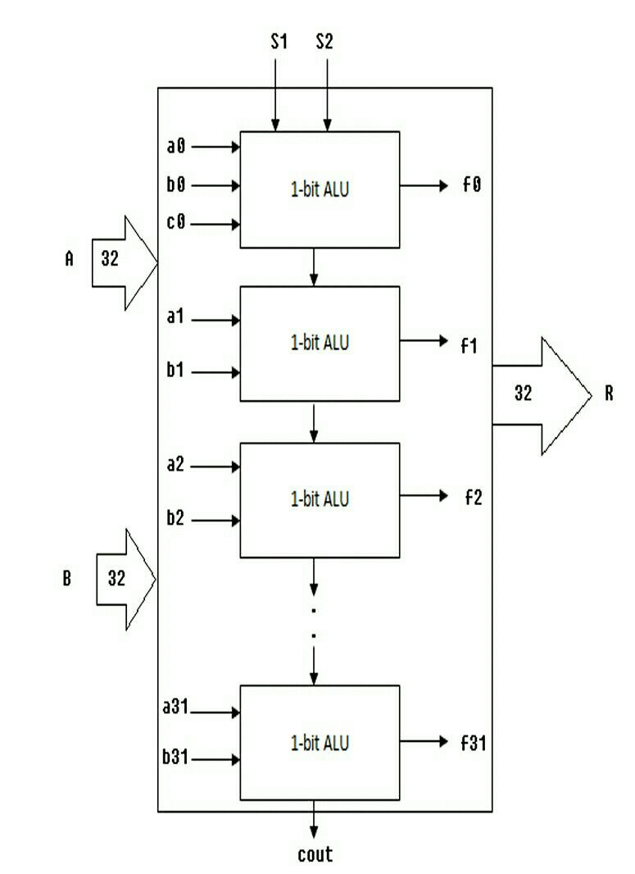
ALU with Irreversible logic gates
The 16 bit ALU is designed which allows the computer to add, subtract, multiplication and division and to perform basic logical operations such as AND, OR, XOR, XNOR, NAND and inverter etc.
An ALU is a combinational logic circuit that can have more inputs and only one output.
Fig. 1 Functional diagram of ALU architecture

Slide 4
ALU WITH REVERSIBLE GATES
In classical irreversible gates, input states cannot be reconstructed from its outputs states.
Therefore, reversible gates are used in which input states can be reconstructed from the output states.
Reversible logic vital in recent years because it has ability to reduce the power dissipation which is main requirement in low power design.

Slide 5
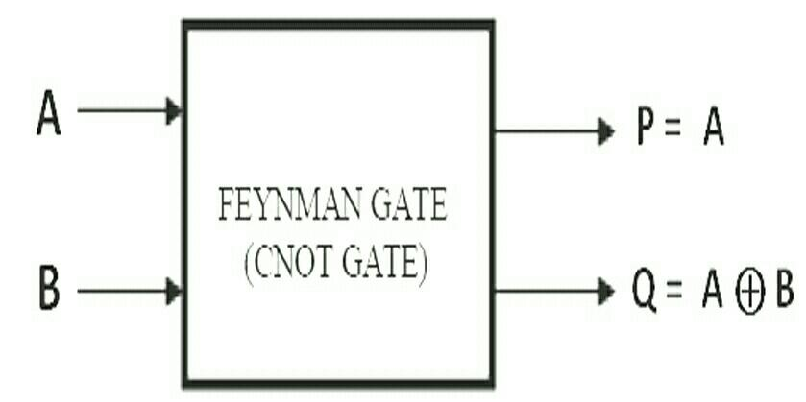
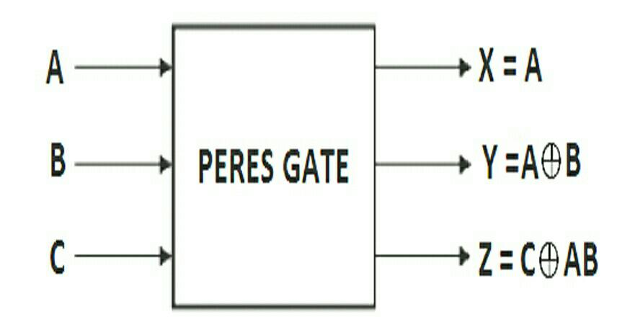
Different Reversible gates

Slide 6
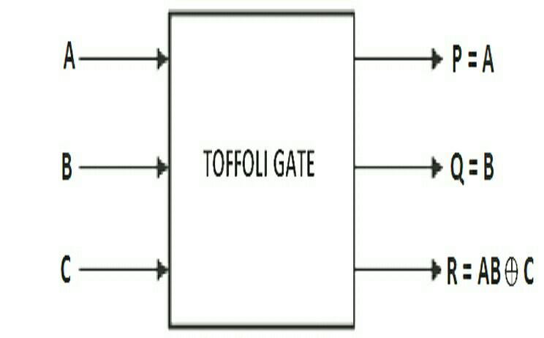
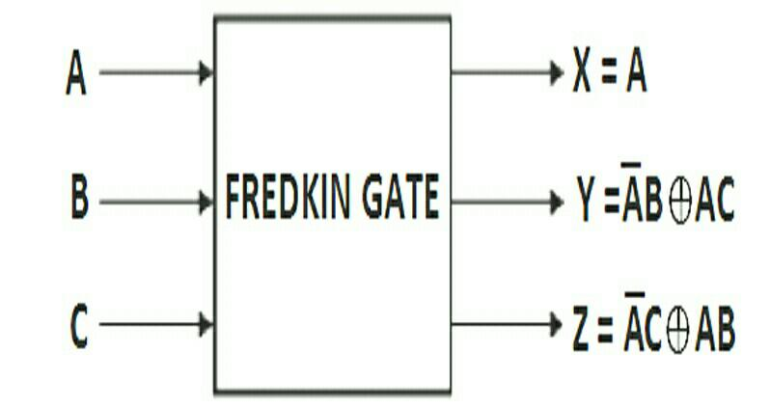
Different Reversible gates

Slide 7
Verilog HDL
Verilog has a variety of constructs as part of it. All are aimed at providing a functionally tested and a verified design description for the target FPGA.
The components of the target design can be described at different levels with the help of the constructs in Verilog
Circuit Level, Gate Level, Gate Level,overall design structure verilog

Slide 8
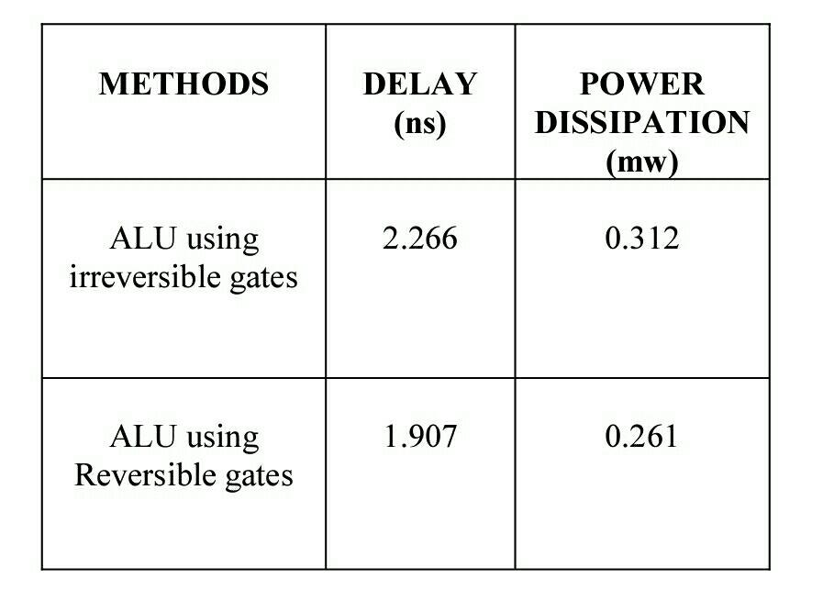
Final analysis
Delay, power dissipation is compared between reversible and irreversible gates.

Slide 9
Thank you

